Slide 1



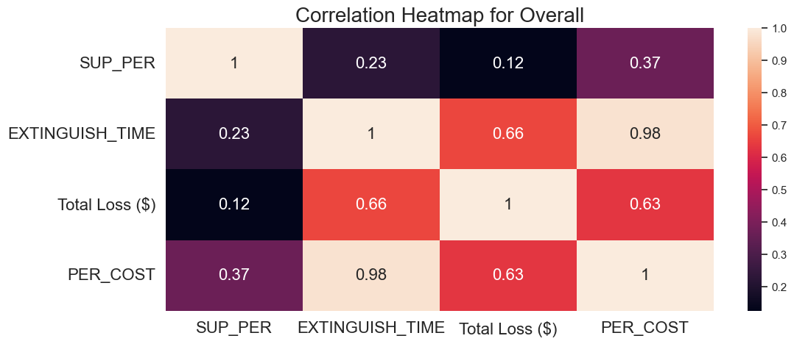
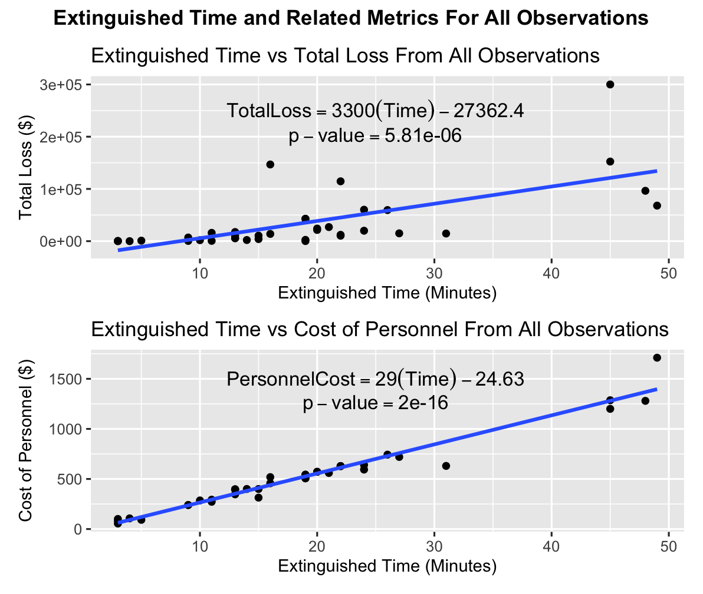
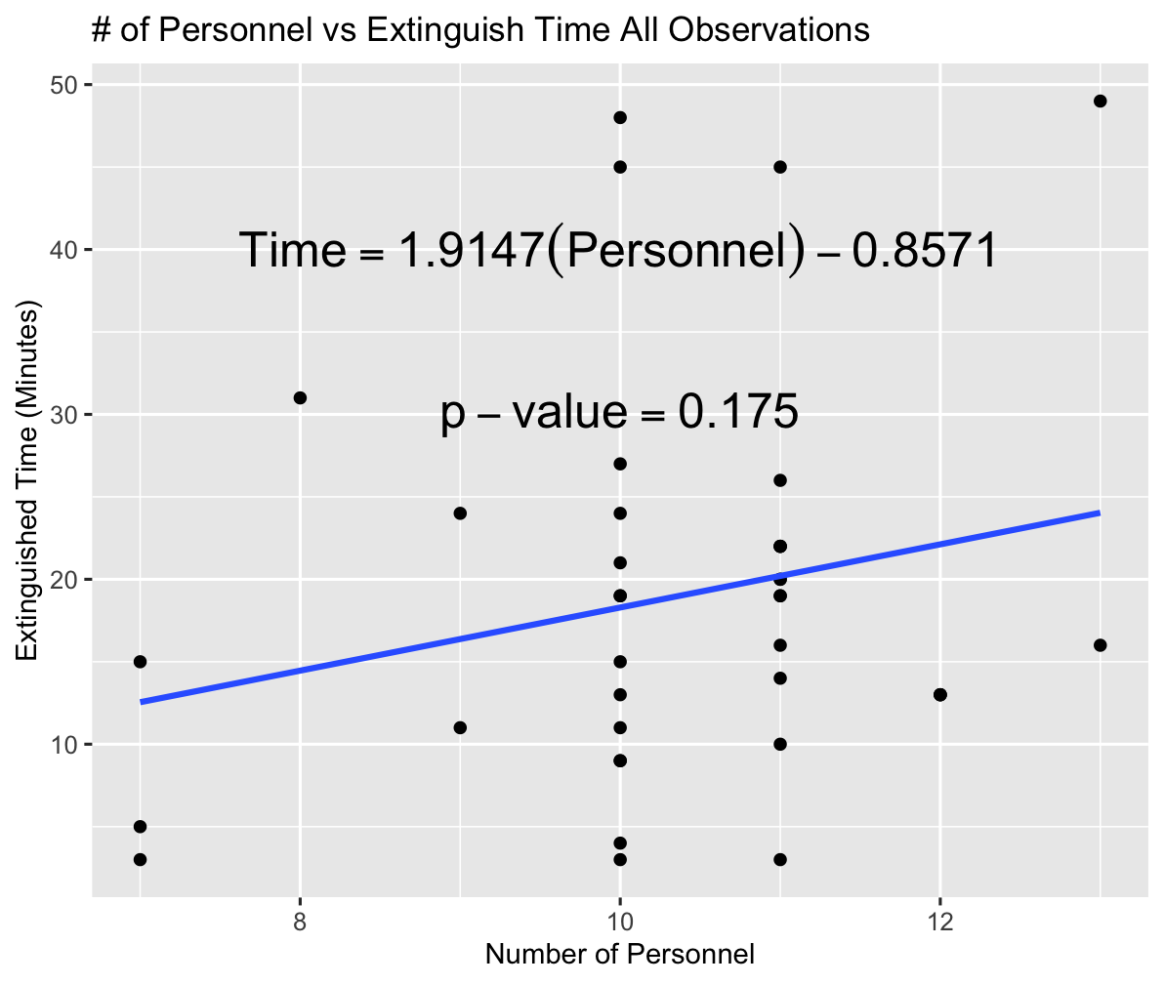
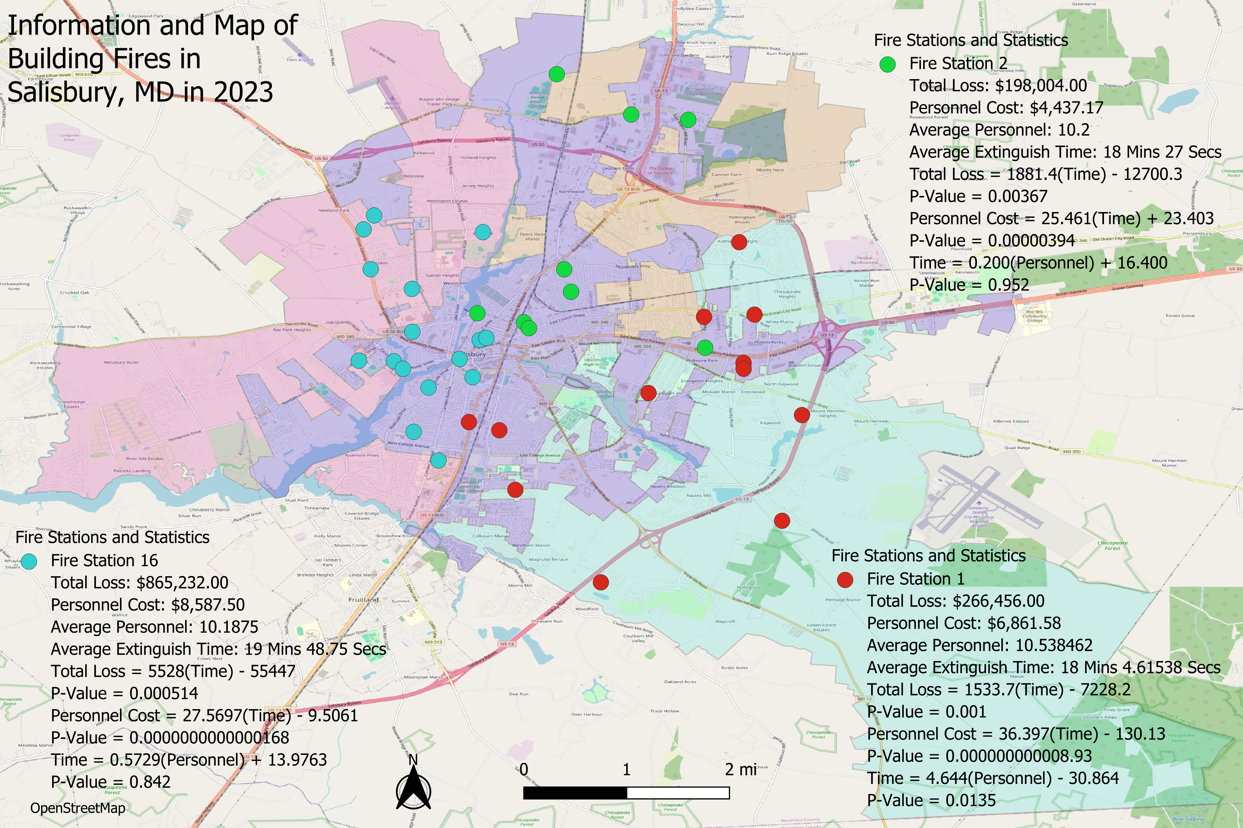
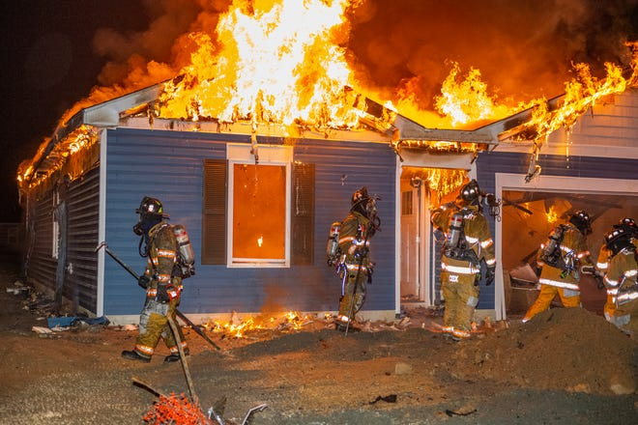
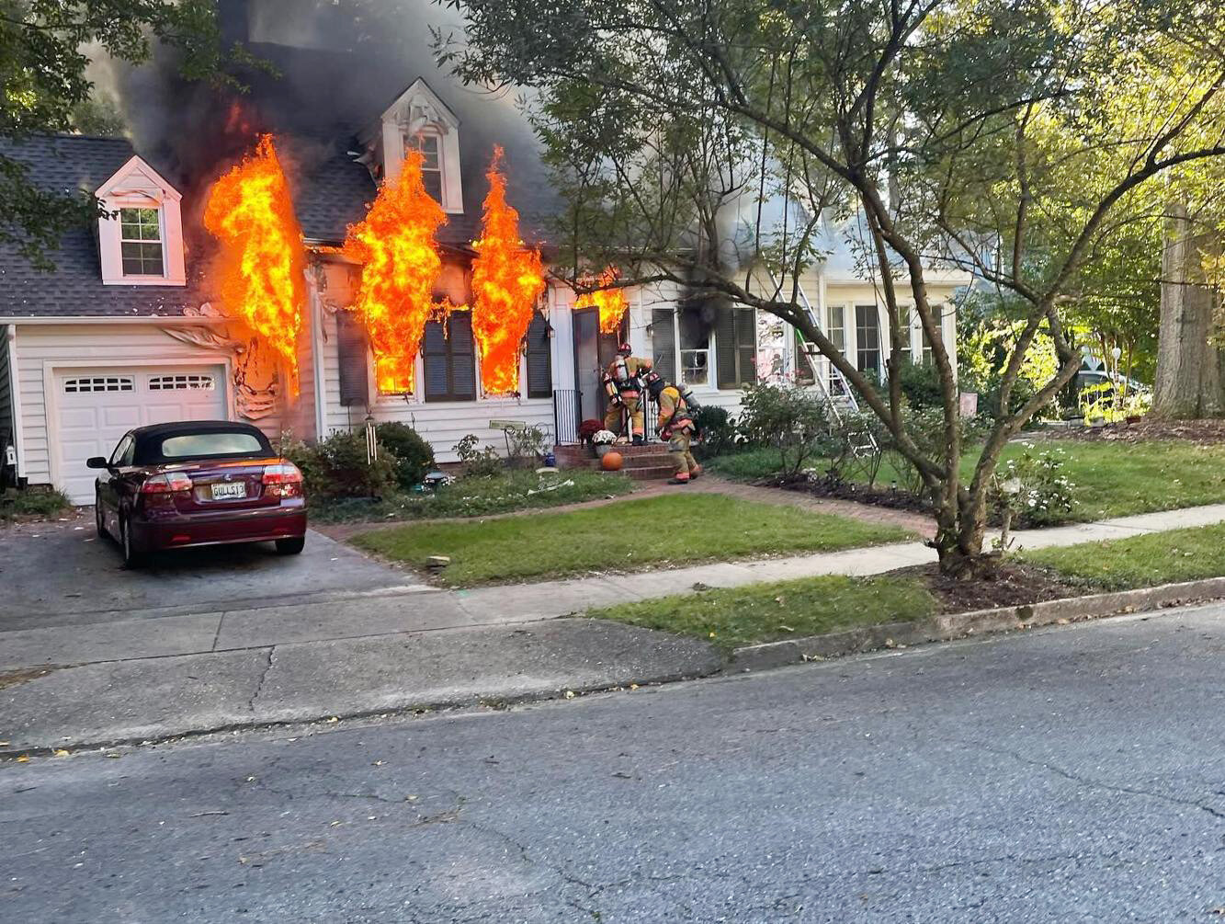
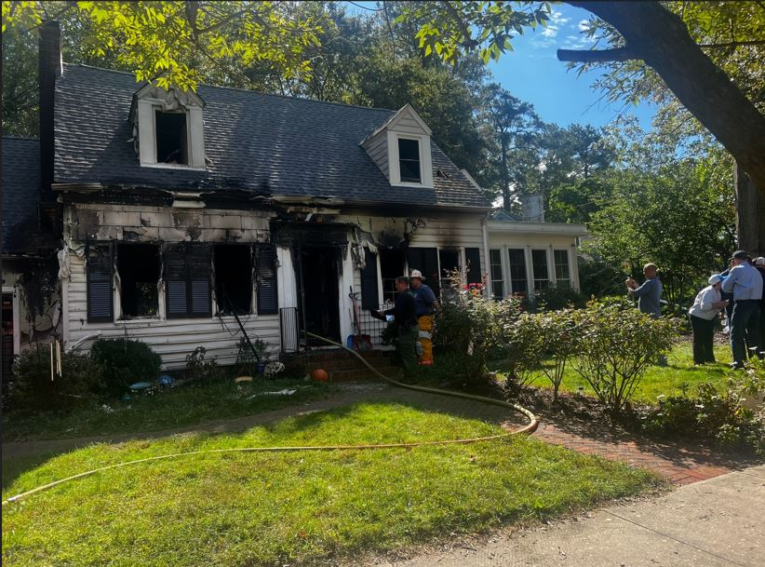
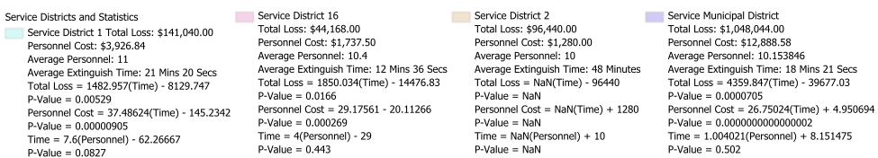


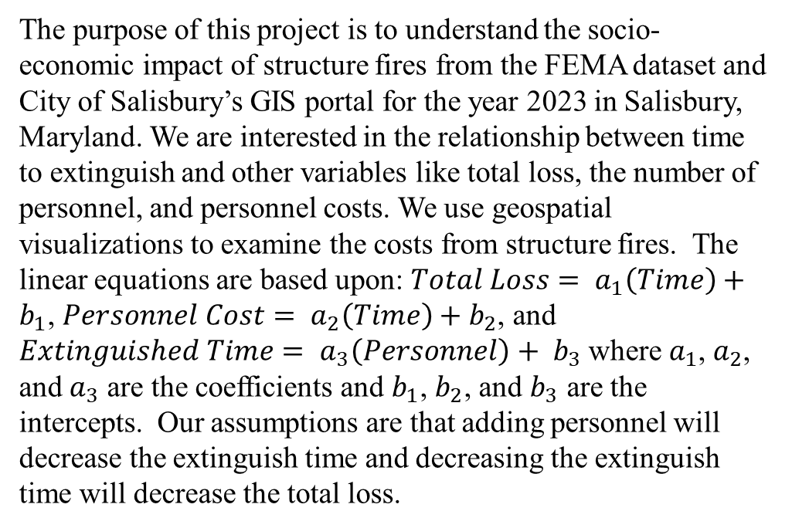
Analyzing Costs Related to 2023 Structure Fires in Salisbury, MD
Authors: Cameron Vinson, Joseph Sanchez, Jackson Griffin, and An Nguyen
Project Advisors: Dr. Kyle Teller, Fire Chief Rob Frampton
Abstract
Discussion
The economic impact of fire incidents extends beyond the losses of property and contents that are typically reported. The total losses from the given fires are not always understood. This project aimed to identify factors that contribute to the costs associated with structure fires in Salisbury, Maryland. We investigated the number of firefighters to send in addition to how the length of time to extinguish the fire affects the total loss amount, and the cost to send a firefighter was also investigated in relation to the time to extinguish.
The p-values are displayed in the visualizations in Figures 2 and 3. The total loss and personnel costs are significant except in Service District 2. This means that the longer it takes to extinguish the fire, the higher the total loss and personnel cost. Since the p-value for the time to extinguish and number of personnel is larger than 0.05, we do not have sufficient evidence to suggest that adding personnel will decrease the time needed to extinguish a fire.
The correlation heatmap in Figure 1 shows that the number of personnel (SUP_PER) is weakly correlated, and the total loss and cost of personnel (PER_COST) are strongly correlated with the time to extinguish in the positive direction.
Introduction
Figure 1: Correlation Heatmap for the dataset
The purpose of this project is to understand the socio-economic impact of structure fires from the FEMA dataset and City of Salisbury’s GIS portal for the year 2023 in Salisbury, Maryland. We are interested in the relationship between time to extinguish and other variables like total loss, the number of personnel, and personnel costs. We use geospatial visualizations to examine the costs from structure fires. The linear equations are based upon: $Total Loss= a_{1}\left(Time\right)+b_{1}$, $Personnel Cost= a_{2}\left(Time\right)+b_{2}$, and $Extinguished Time= a_{3}\left(Personnel\right)+ b_{3}$where $a_{1}$, $a_{2}$, and $a_{3}$ are the coefficients and $b_{1}$, $b_{2}$, and $b_{3}$ are the intercepts. Our assumptions are that adding personnel will decrease the extinguish time and decreasing the extinguish time will decrease the total loss.
Future Work
To further analyze the data, a kernel density analysis heatmap could show areas with more or fewer structure fires. Transformations can be done on the dataset along with each service district and fire station to provide better models and improve the estimations. Tax and weather analysis can be used as additional factors. The citywide analysis can be done for each service district and fire station to provide more granular information. The QR Code links to a public GitHub repository with code and a research paper that will be completed by May 21, 2025.
Figure 2: Scatterplots and model visualizations for the dataset
Methods
The Fire Stations are designated as 1, 2, and 16. Service Districts include the Municipal District and Service Districts 1, 2, and 16. Google Maps was used to geocode the data. We used Python libraries to visualize the correlation heatmap and create data for QGIS. The map and statistics of each fire station and service district were provided in a QGIS layout. We used R Studio to find relationships between the time to extinguish versus other features and to visualize the scatterplots with the linear equation line using the annotate package.
Figures 4-6: Actual house fires in Salisbury during 2023
References
Cupp, K. (2025). Service Response Districts [Shapefile]. City of Salisbury GIS Open Data Hub. https://salisbury-gis-open-data-hub-salisbury.hub.arcgis.com/datasets/83ae60edda95483a8d65802eb222a206_1
Federal Emergency Management Agency. (2024). FEMA USFA NFIRS 2023 All Incidents (Annual) [Data set]. U.S. Department of Homeland Security. https://www.fema.gov/about/openfema/data-sets/fema-usfa-nfirs-annual-data
Based on a template created by:
at Salisbury University
Figure 3: Map, statistics, and linear models of Fire Stations and Service Districts

